Slide 1
SWIPE, SPEND, SAVE
MANAGING CREDIT CARDS with PostgreSQL

Slide 2
Introduction
Database Design
Data Modeling
Query Optimization
Security and Compliance
Conclusion

Slide 3

INTRODUCTION
Welcome to our presentation on Credit Card Management System in SQL.
In today's digital world, credit cards are a ubiquitous part of our lives. With the increasing use of credit cards, it is essential to have an efficient and secure system for managing them. This is where a Credit Card Management System in SQL comes into play. It is a powerful tool that helps in organizing and managing credit card data efficiently. This system is crucial for businesses that deal with a large volume of credit card transactions on a daily basis.

Slide 4

DATABASE DESIGN
The database design for a credit card management system in SQL involves creating tables that store information about Customers, Credit Cards, Transactions, Bill Payments, and Offers & Benefits.
It is important to design the database in a way that is efficient and scalable. This means minimizing redundant data and ensuring that the database can handle a large volume of transactions. Normalization is a technique used to achieve this goal, which involves breaking down tables into smaller, more specialized tables to eliminate redundancy and improve performance.

Slide 5
Each table has a primary key which uniquely identifies each record in the table. The tables are then linked together using foreign keys to create relationships between them. For example, the credit card table would have a foreign key that links it to the customer table, indicating which customer owns the credit card.

Slide 6
DATA MODELLING
Data modeling is a critical aspect of designing a any project in SQL. It involves identifying the entities, attributes, and relationships between them to create an efficient and effective data model.

Slide 7
ER DIAGRAM
One popular technique for data modeling is the entity-relationship (ER) model. By using this technique, designers can easily visualize the structure of the database and make adjustments as necessary.

Slide 8
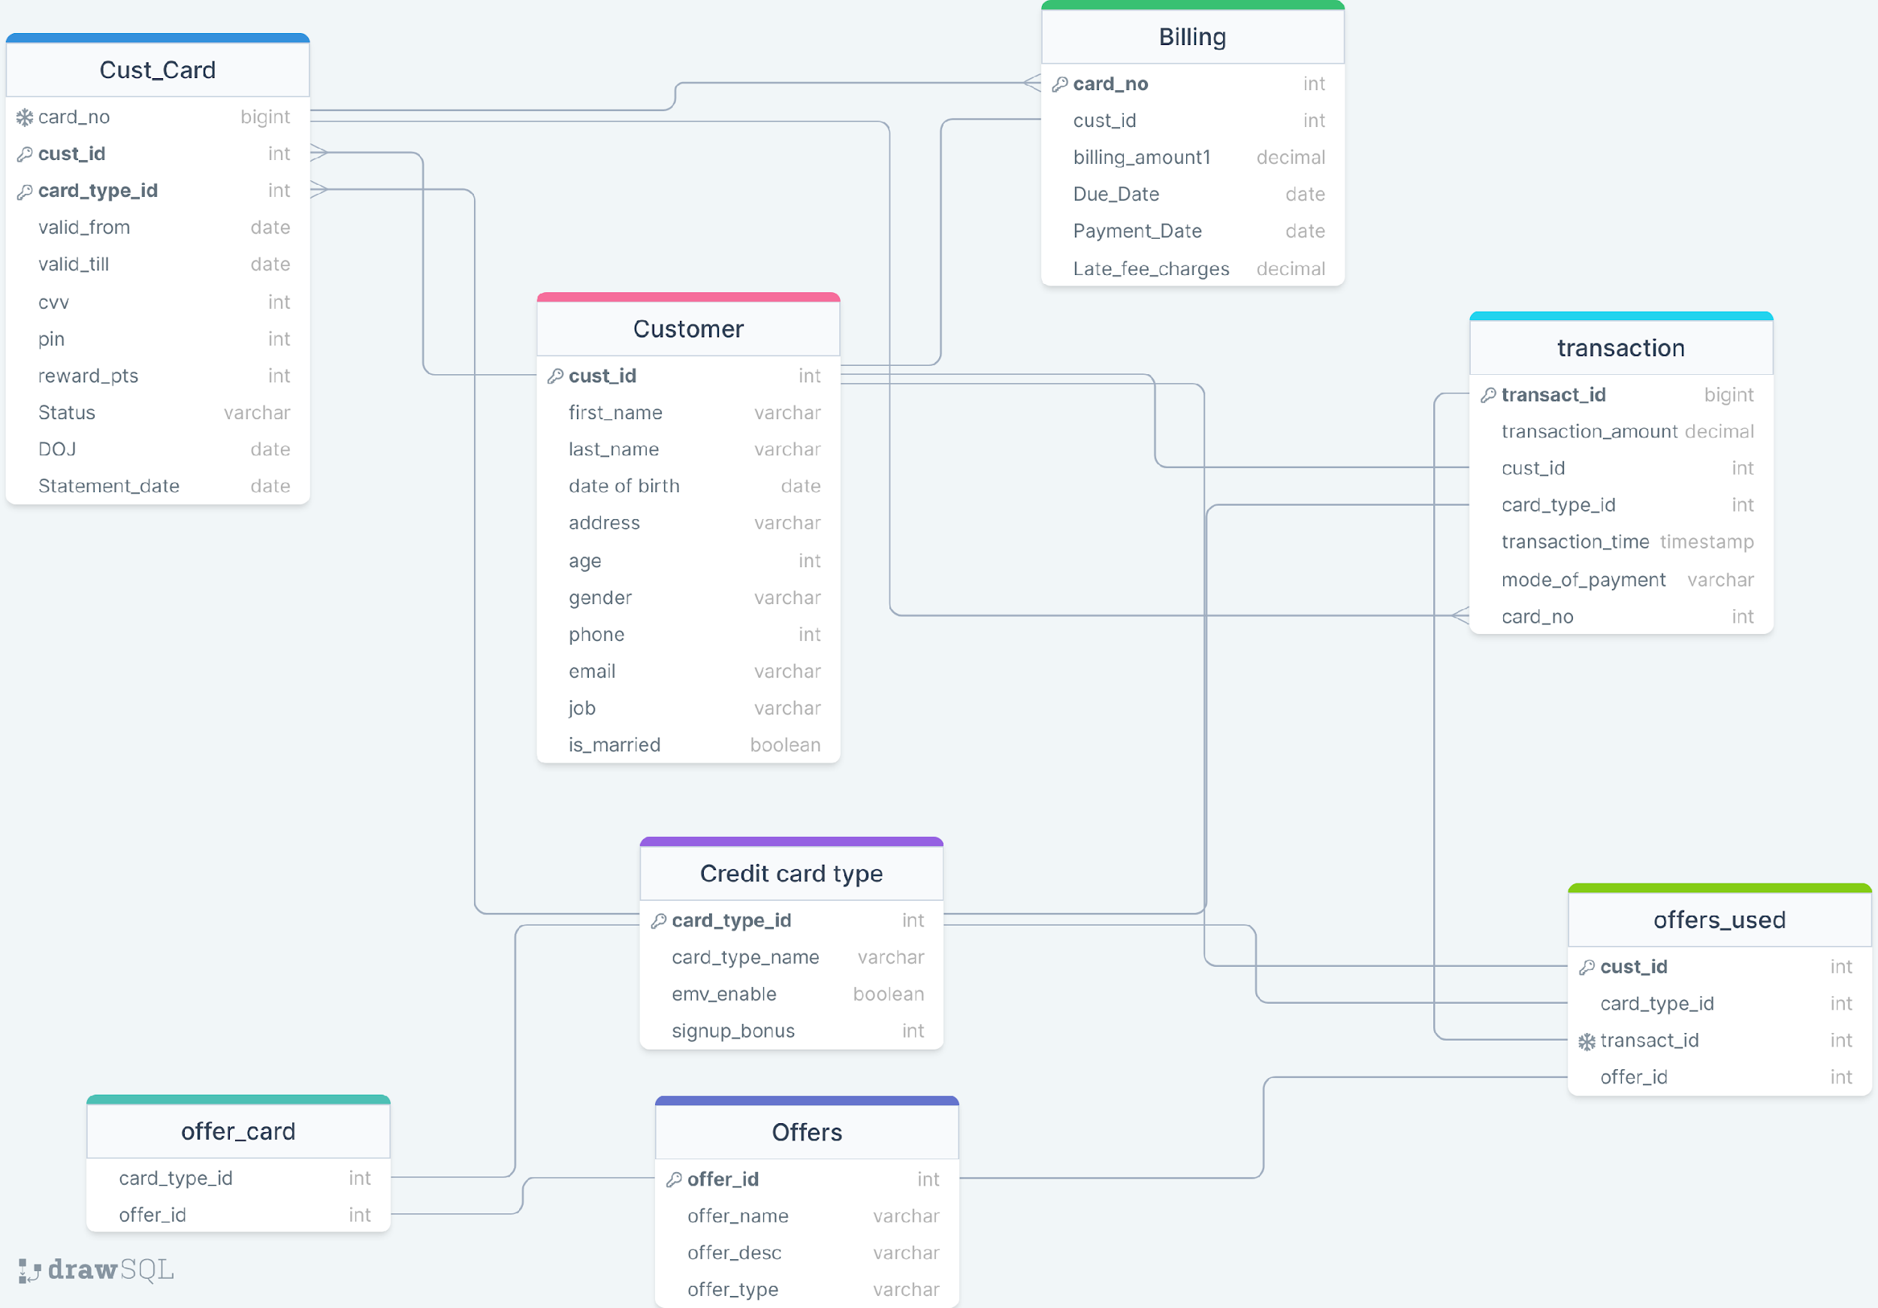

Slide 9
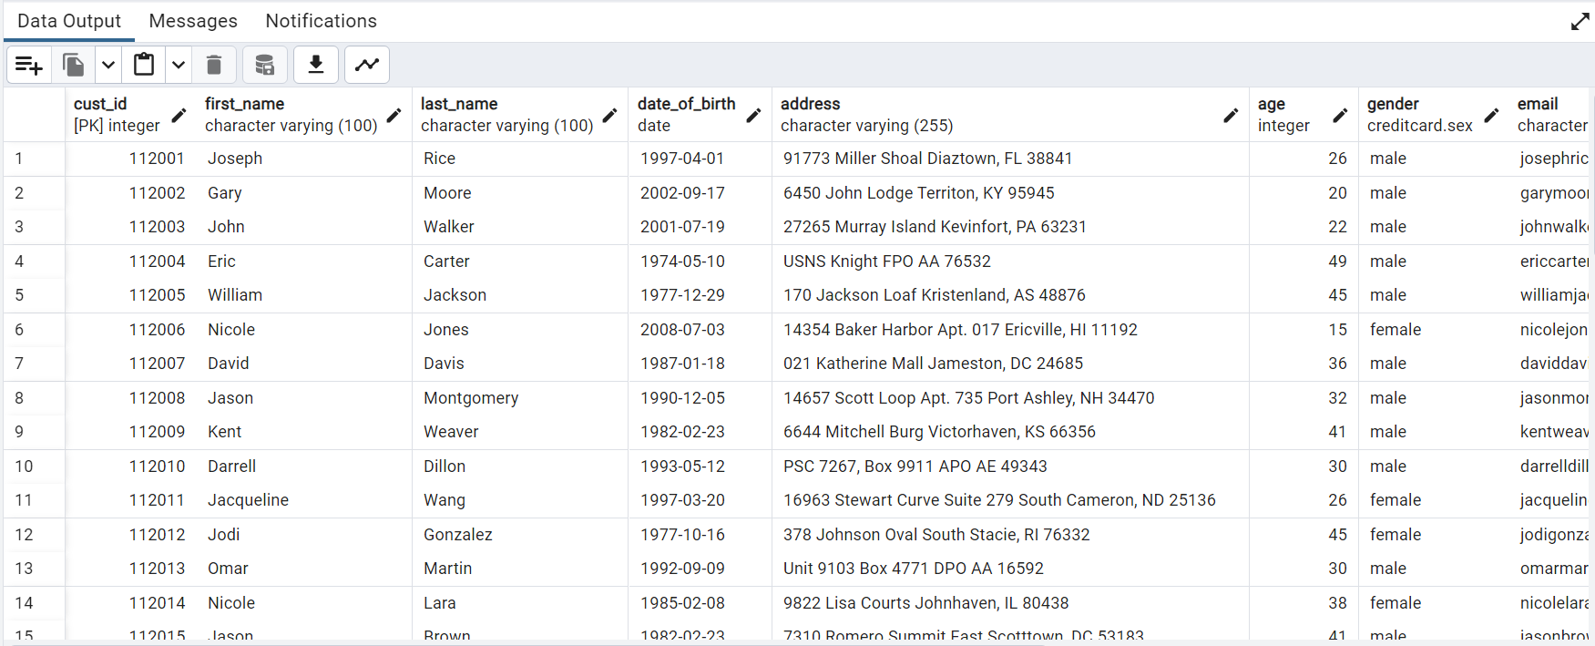
CUSTOMER TABLE
cust_id: Customer ID (Primary Key)
first_name: First name of the customer
last_name: Last name of the customer
date of birth: Customer's date of birth
address: Customer's address
age: Age of the customer
gender: Gender of the customer
phone: Phone number of the customer
email: Email address of the customer
job: Customer's occupation or job
is_married: Marital status of the customer
The "Customer" table holds comprehensive information about credit card holders, including personal details, contact information, demographics, and employment status, facilitating tailored services and communication.

Slide 10
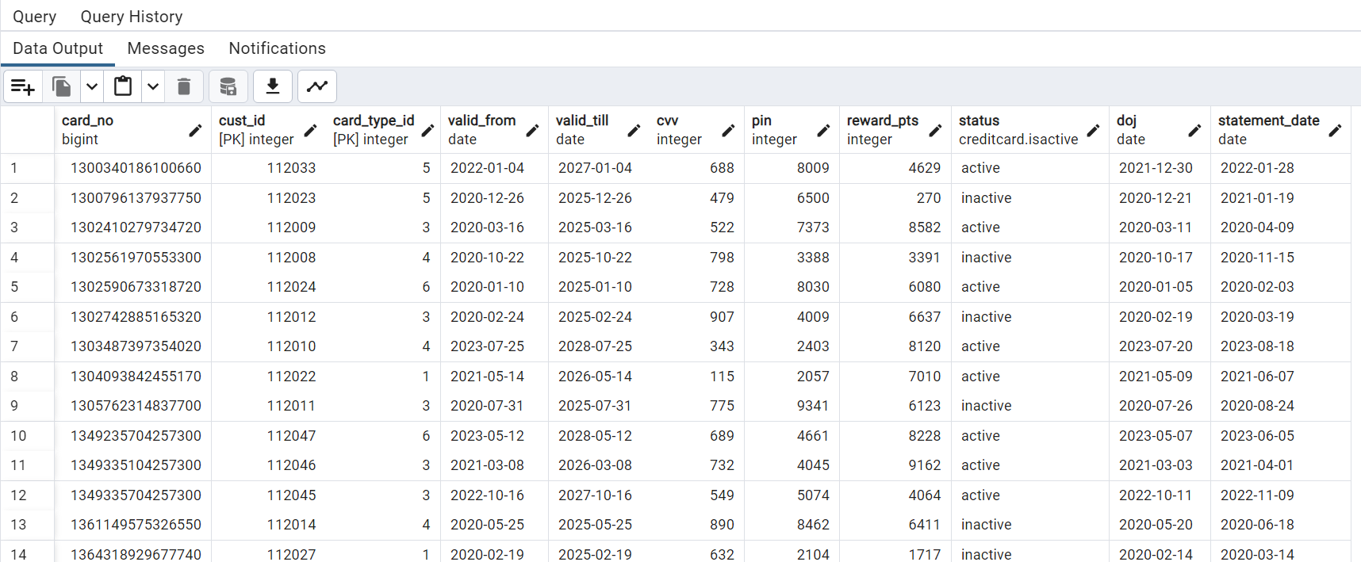
CUST_CARD TABLE
cust_id: Customer ID (Composite Key)
card_type_id: Card type ID (Composite Key)
card_no.: Card number (Unique)
valid_from: Valid from date
valid_till: Valid till date
cvv: Card verification value
pin: Personal identification number
reward_pts: Reward points
Status: Card status
DOJ: Date of joining
statement_date: Statement date
“This table stores credit card information for customers, including card details, validity, security features, rewards, and status.”

Slide 11
OFFERS TABLE
offer_id: An exclusive identification number for each offer entry. (Primary Key)
offer_name: The descriptive title of the offer designed for credit card holders.
offer_desc: A concise yet informative explanation of the specific benefits and advantages the offer provides.
offer_type: Categorization of the offer, such as cashback, discounts, travel rewards, or points accumulation.

Slide 12
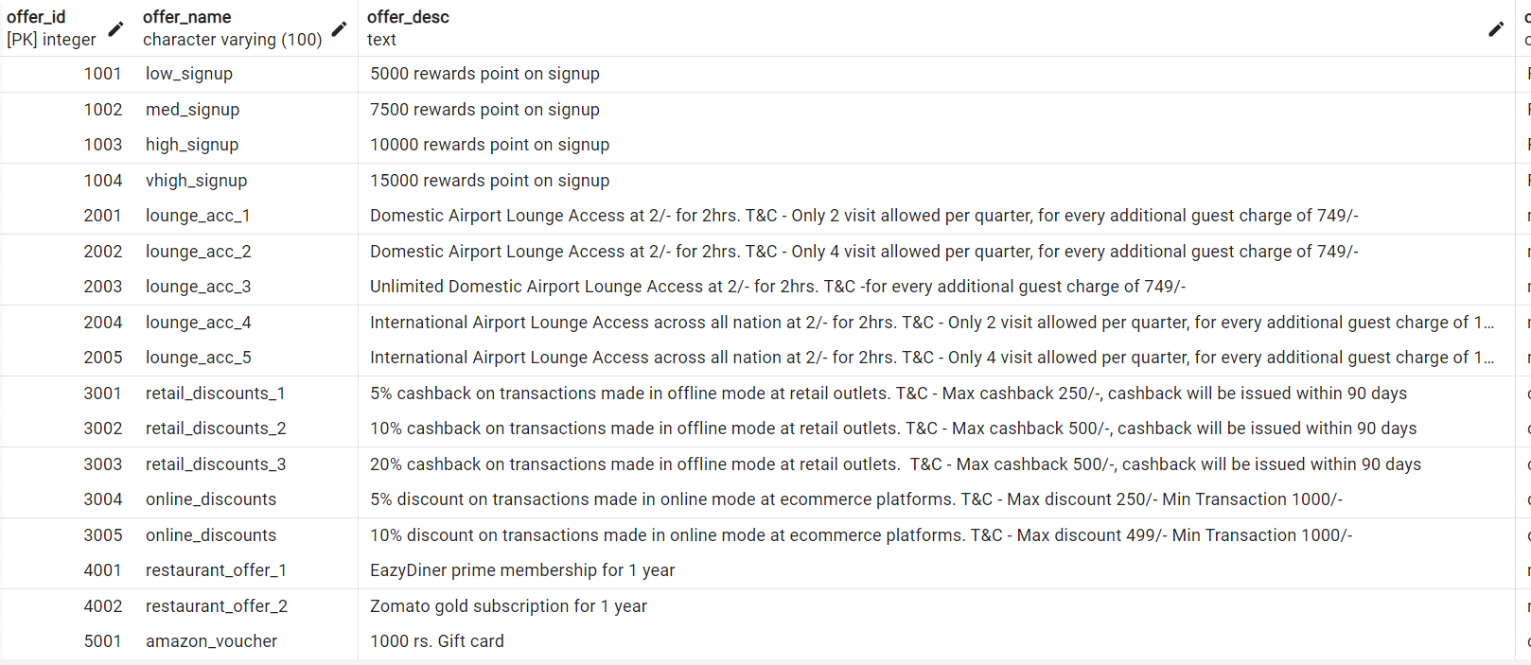
“Within the "Offers" table, these attributes collectively contribute to the systematic organization and management of diverse credit card promotional offers, enriching customer engagement and satisfaction.”

Slide 13
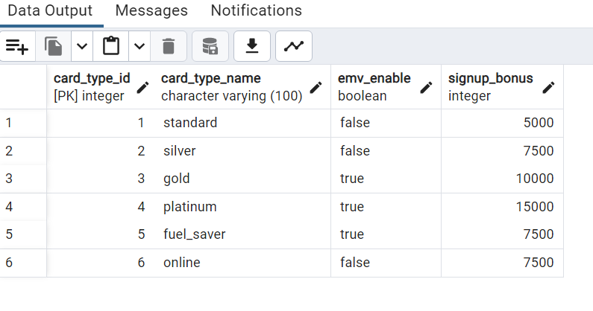
CREDIT CARD TYPE TABLE
card_type_id: A unique identifier for each distinct card type entry within the database. (Primary Key)
card_type_name: The descriptive label assigned to a specific card type, aiding in differentiation.
emv_enable: Indicates whether the card type supports EMV chip technology, enhancing security.
signup_bonus: Records any special incentive offered to customers upon signing up for the card type.
“In the "Credit Card Type" table, these attributes collectively contribute to effective card type management, enabling streamlined categorization, enhanced security features, and the tracking of promotional signup benefits. This fosters a dynamic credit card offering environment tailored to diverse customer needs.”

Slide 14
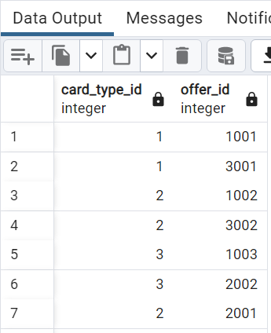
OFFER CARD TABLE
card_type_id: A reference to the unique ID of a specific card type, establishing a relationship between card types and offers.
offer_id: Corresponds to the distinctive ID of an offer, creating a connection between credit card types and available offers.
“In the "Offer Card" table, these attributes collectively enable the creation of links between different credit card types and the various promotional offers they are eligible for. This relationship facilitates strategic marketing campaigns and personalized promotions, contributing to an adaptable and customer-centric credit card management system.”

Slide 15
BILLING TABLE
card_no: Card number (Foreign Key) (Primary Key)
cust_id: Customer ID (Foreign Key)
billing_amount: Amount to be billed (Total of transaction amt from transaction table grouped by card_no.)
due_date: Payment due date
payment_date: Date of payment
late_fee_charges: Charges for late payments

Slide 16
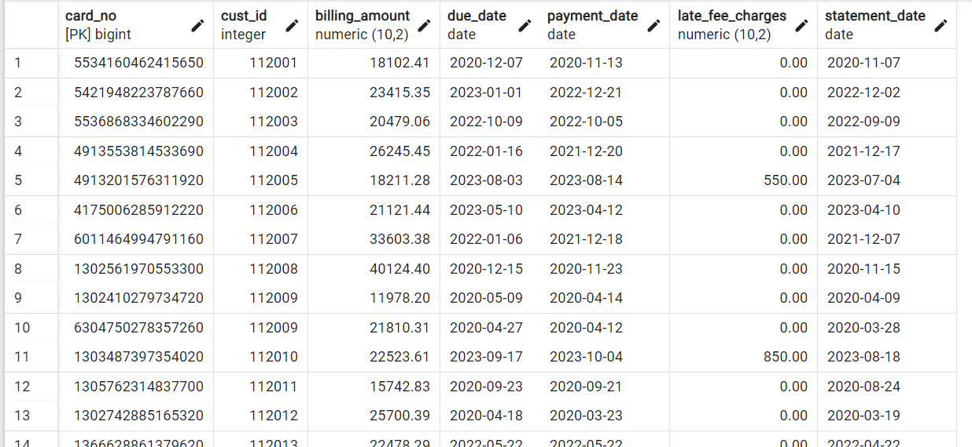
“The "Billing" table stores billing information, including card and customer references, amounts, payment timelines, and charges, ensuring effective management of credit card transactions and payment processing.”

Slide 17
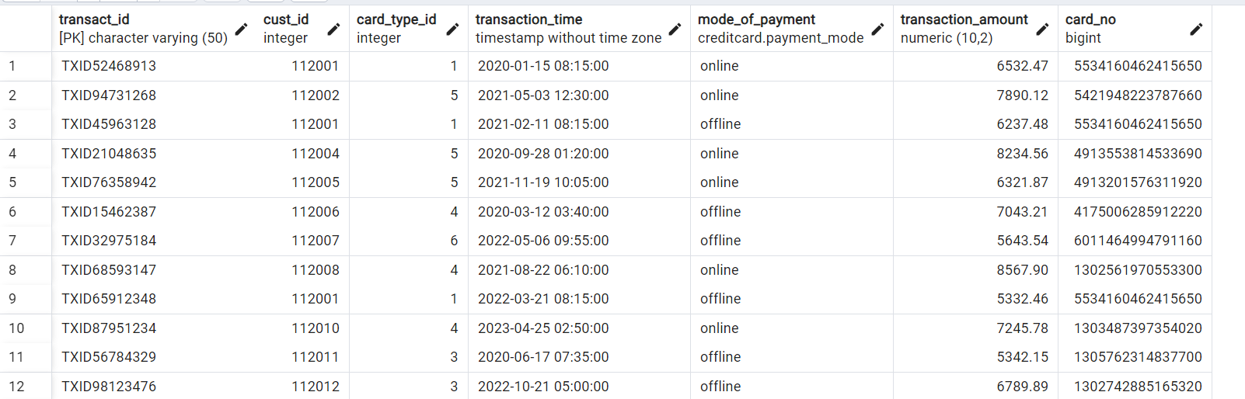
TRANSACTION TABLE
transaction_id: Transaction ID (Primary Key)
cust_id: Customer ID (Foreign Key)
card_type_id: Card type ID (Foreign Key)
transaction_time: Time of transaction
mode_of_payment: Payment method
card_no: Card number (Foreign Key)
transaction_amount: Amount of the transaction
“The "Transaction" table captures transaction details, including customer and card references, timestamps, payment methods, and transaction amounts. This facilitates meticulous tracking of credit card activities and financial analysis within the management system.”

Slide 18
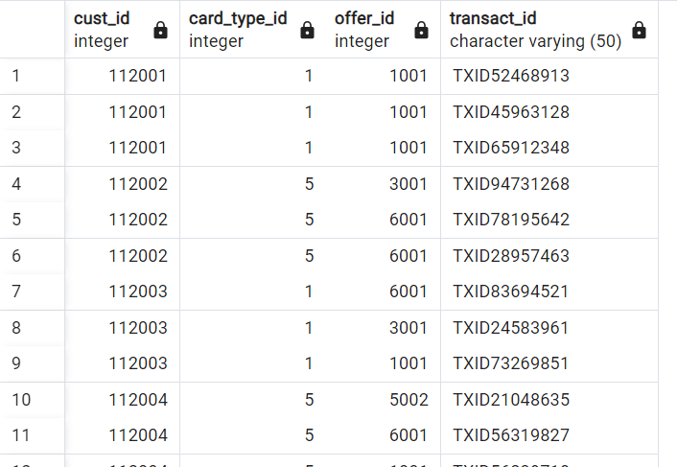
OFFERS USED TABLE
cust_id: Customer ID (Foreign Key)
card_type_id: Card type ID (Foreign Key)
transact_id: Transaction ID (Foreign Key)
offer_id: Offer ID (Foreign Key)
“The "Offers Used" table establishes connections between customers, card types, transactions, and offers, providing insight into which offers were utilized by customers during transactions. This aids in evaluating the effectiveness of promotional campaigns and customer engagement strategies.”

Slide 19
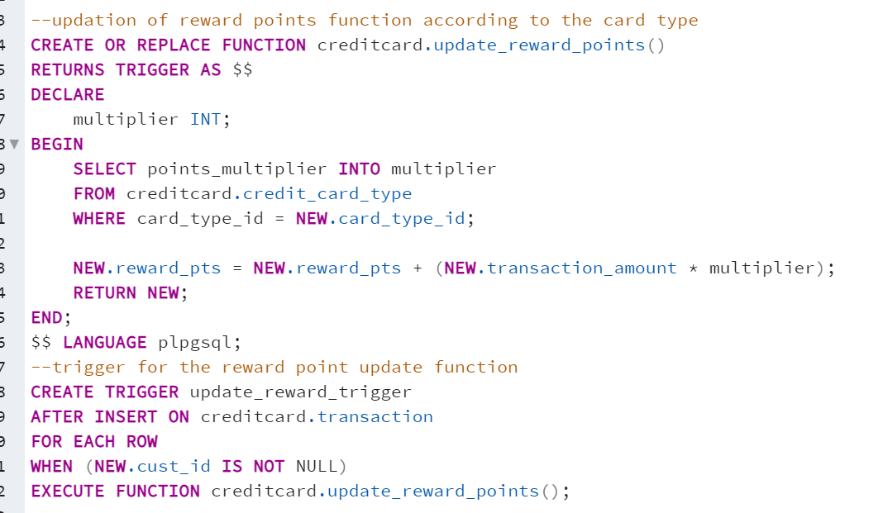
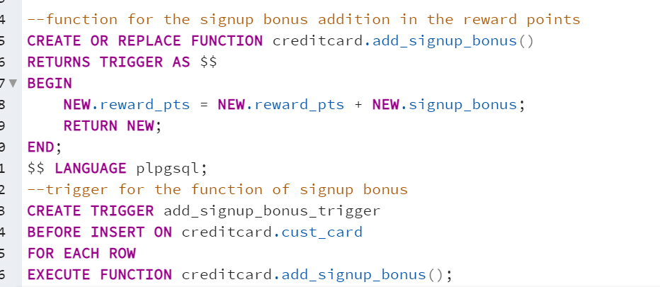
UNIQUE FEATURES
TRIGGERS AND STORED PROCEDURES
2. Signup Bonus Addition:
The script also includes a function `add_signup_bonus()` that enhances the reward points by adding a signup bonus to a customer's credit card. This function is executed prior to inserting a new record into the `creditcard.cust_card` table.
1. Reward Points Management:
It defines a function `update_reward_points()` that adjusts the reward points for credit card transactions based on the card type's multiplier. This function is triggered automatically after each new transaction insertion, as long as the customer ID is not null.

Slide 20
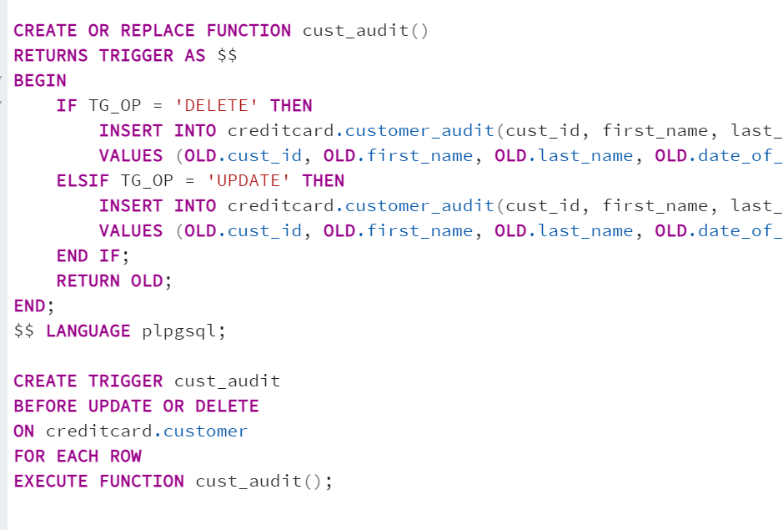
UNIQUE FEATURES
BACKUP AND AUDIT TABLES
Function `cust_audit()` and a trigger to track changes in the "creditcard.customer" table. The function captures deleted or updated customer data, recording it in the "customer_audit" table with timestamp and relevant attributes.

Slide 21
SECURITY AND COMPLIANCE
In any credit card management system, security and compliance are of utmost importance. This is because such systems deal with sensitive financial information, which can be targeted by hackers and other malicious actors. To ensure that the system is secure, it is important to implement robust security measures such as encryption, firewalls, and access controls.
Compliance with regulatory requirements such as PCI DSS is also crucial for any credit card management system. Failure to comply with these regulations can result in severe penalties and loss of trust from customers. It is important to regularly audit the system to ensure compliance and address any issues that may arise.

Slide 22
CONCLUSION
In conclusion, we have discussed the importance of having a credit card management system in SQL. By implementing best practices in database design and data modeling, we can ensure that our system is efficient and effective. Query optimization is also crucial for improving system performance. Additionally, security and compliance measures are essential to protect sensitive information and maintain regulatory compliance.
By following these best practices, we can improve the overall functionality and security of our credit card management system. We encourage you to implement these strategies in your own systems to ensure the best possible outcomes for your business and customers.

Slide 23
THANK YOU
Team: Netbusters

